Slide 1
WARDROBE CATEGORIZATION
Domain: Artificial Intelligence with python
Prepared and Submitted for Internship Review
By: Ch. V. N. S. Sai Divyesh
19JN1A0524
IV B. Tech CSE-A
SVCN

Slide 2
Details of internship
Company Name: Coincent
Company Address: #1209, 4th floor, 22nd Cross Rd, 7th sector, HSR Layout, Bengaluru, Karnataka 560102
Company Contact No.: +91 9886550360
Company Email: support@coincent.ai
Company Website: www.coincent.ai
Internship Duration: 12th August 2022 – 5th September 2022
Internship Mode: Online

Slide 3
outline
Week 1: Introduction to Python Programming, Google Collab, Datatypes and Operators in Python, Loops in Python, Python Data Structures, Python Functions
Week 2: Introduction to Pattern Recognition, Artificial Intelligence, Types of AI, Introduction to Machine Learning, Supervised Learning, Unsupervised Learning, Reinforcement Learning
Week 3: Introduction to Computer Vision, OpenCV using Python, NumPy, Pandas and Matplotlib Libraries in Python
Week 4: Major Project: Wardrobe Categorization

Slide 4
Introduction to python
Python is a programming language, first released by Guido van Rossum in the year 1991.
Python is now one of the top 5 programming languages in the world.
There are different versions of Python released: Python 2.0 (2000), Python 2.7 (2010), Python 3.0 (2008), now the newest version is Python 3.10.
Some real-world applications of Python are:
Artificial Intelligence and Machine Learning
Game Development
Software Development
Scientific and Numeric Applications
Web Development

Slide 5
google collab
Visit www.colab.research.google.com.
Sign-in with your Google Account.
Click on File button and create New Notebook where you can start executing your Python code.
You don’t need to install any modules to run any code.
You can share your Google Collab notebooks very easily with anyone.

Slide 6
Python data structures
Strings: A string is a sequence of characters. A character is simply a symbol. Strings can be created by enclosing characters inside a single quote or double-quotes. Even triple quotes can be used in Python but generally used to represent multiline strings and docstrings.
Ex:
my_string = “Hello”
print(my_string)
Lists: Python lists are one of the most versatile data types that allow us to work with multiple elements at once. A list is created by placing elements inside square brackets [ ], separated by commas. A list can have any number of items and they may be of different types (integer, float, string, etc.).
Ex:
my_list = [2,3.0,“Hello”]
print(my_list)

Slide 7
Python data structures
Tuples: A tuple in Python is similar to a list. The difference between the two is that we cannot change the elements of a tuple once it is assigned whereas we can change the elements of a list. A tuple is created by placing all the elements inside parentheses ( ), separated by commas. A tuple can have any number of items and they may be of different types (integer, float, list, string, etc.).
Ex:
my_tuple = (2,3.0,“Hello”)
print(my_tuple)
Sets: A set is an unordered collection of items. Every set element is unique (no duplicates) and must be immutable (cannot be changed). A set itself is mutable. A set is created by placing all the elements inside curly braces { }, separated by commas. To make a set without any elements, we use the built-in function set( ) without any arguments.
Ex:
my_set = {1,2,3,5,7}
print(my_set)

Slide 8
Python data structures
Dictionaries: Python dictionary is an unordered collection of items. Each item of a dictionary has a key/value pair. Dictionaries are optimized to retrieve values when the key is known. Creating a dictionary is as simple as placing items inside curly braces { }, separated by commas. An item has a key and a corresponding value that is expressed as a pair (key: value). While the values can be of any data type and can repeat, keys must be of immutable type and must be unique.
Ex:
my_dict = {“name”:“Jack”,“age”:26}
print(my_dict)

Slide 9
Artificial intelligence
AI enables us to build amazing software that can
improve health care,
enable people to overcome physical disadvantages,
empower smart infrastructure,
create incredible entertainment experiences,
and even save the planet!!
Simply put, AI is the creation of software that imitates human behaviours and capabilities.
The Turing Test, proposed by Alan Turing (1950) was designed to provide a satisfactory definition of AI. The computer would need to possess the following capabilities:

Slide 10
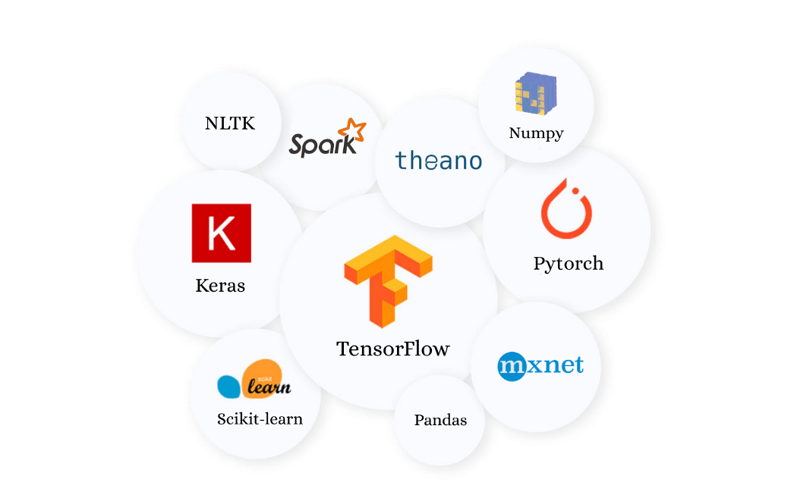
Artificial intelligence
Machine Learning: This is often the foundation for an AI system, and is the way we “teach” a computer model to make prediction and draw conclusions from data. Some of the libraries used in Python to perform ML tasks are:

Slide 11
Artificial intelligence
Anomaly Detection: The capability to automatically detect errors or unusual activity in a system.
Natural Language Processing: The capability of a computer to interpret written or spoken language, and respond accordingly. Scikit-learn is the best library in Python used to perform NLP.
Computer Vision: The capability of software to interpret the world visually through cameras, videos and images. OpenCV is the best library in Python used to perform computer vision.
TYPES OF AI:
Narrow/Weak AI: This is a type of AI which is able to perform a dedicated task (only one task) with intelligence. It is the most commonly and currently available AI.
General/Strong AI: This is a type of AI which could perform any intellectual task with efficiency like a human. The worldwide researchers are now focused on developing machines with general AI.
Super AI: This is a level of intelligence of systems that machines could surpass human intelligence and can perform any task better than human. It is an outcome of general AI.

Slide 12
Machine learning
Machine Learning is an application of AI that provides systems the ability to automatically learn and improve from experience without being explicitly programmed.
Simply, ML is a technique of converting information into knowledge.
Machine Learning is generally classified into 3 types:
Supervised Learning
Unsupervised Learning
Reinforcement Learning

Slide 13
Supervised learning
Supervised Learning is a type of machine learning where you have input variables (X) and an output variable (Y) and you use an algorithm to learn the mapping function from the input to the output.
Y = f(X)
Supervised Learning is classified into 2 types:
Classification: Classification predictive modelling is a task of approximating a mapping function (f) from input variables (X) to discrete output variables (Y) (classes). Here, the output variable is usually a category such as red or blue.
Some classification algorithms are: Decision Tree Induction, Naïve Bayes Classification, Classification by Back Propagation, Support Vector Machines (SVM).
Regression: Regression predictive modelling is a task of approximating a mapping function (f) from input variables (X) to real or continuous output variables (Y). Here, the output variable is usually a real value such as weight.

Slide 14
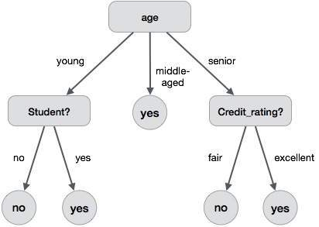
supervised learning
Classification by Decision Tree Induction: A decision tree is a flowchart-like structure where,
each internal node denotes a test on an attribute
each branch represents an outcome of the test
each leaf node holds a class label
topmost node is the root node

Slide 15
unsupervised learning
Unsupervised Learning allows us to approach problems with little or no idea what our results should look like i.e., you only have input data (X) and no corresponding output variables.
Unsupervised Learning is classified into 2 types:
Clustering: A clustering problem is the one where you want to discover the inherent groupings of data, such as grouping customers by their purchasing behaviour.
Some clustering algorithms are: k-means Algorithm, k-medoids Algorithm.
Association: An association rule learning problem is the one where you want to discover the rules that describe large portions of your data, such as people that buy bread also tend to buy milk.
Some association rule learning algorithms are: Apriori Algorithm, FP Growth Algorithm.

Slide 16
Unsupervised learning
k-Means Clustering Algorithm: There are 4 steps in this algorithm:
Partition objects into k non-empty subsets, called clusters.
Compute seed points as the centroids of the clusters of the current position.
Assign each object to the cluster with the nearest seed point.
Go back to step 2. Stop when no more new assignment.
Ex: O={2,3,4,10,11,12,20,25,30} and k=2
M1=4 and M2=12
C1={2,3,4} and C2={10,11,12,20,25,30} and so on until no more new assignment.

Slide 17
unsupervised learning
Association Rule Learning using IF-THEN rules: An example for association rule is:
IF buys(X, bread) THEN buys(X, milk);
One of the measures used for association rule learning is Lift measure.
Lift(A, B)=P(AUB) / P(A).P(B)
If Lift(A,B)<1, then A is negatively correlated to B.
If Lift(A,B)>1, then A is positively correlated to B.
If Lift(A,B)=1, then A is not correlated to B.

Slide 18
reinforcement learning
Reinforcement Learning is a feedback-based Machine learning technique in which an agent learns to behave in an environment by performing the actions and seeing the results of actions.
For each good action, the agent gets positive feedback or reward, and for each bad action, the agent gets negative feedback or penalty.
Reinforcement Learning is classified into 2 types:
Active Reinforcement Learning: In active RL, an agent needs to decide what to do as there is no fixed policy that it can act on.
Passive Reinforcement Learning: In passive RL, the agent’s policy is fixed i.e., it is told what to do.

Slide 19
Computer Vision
Computer vision is a field of artificial intelligence (AI) that enables computers and systems to derive meaningful information from digital images, videos and other visual inputs and take actions or make recommendations based on that information. Two essential technologies are used to accomplish this: a type of machine learning called deep learning and a convolutional neural network (CNN).
Machine learning uses algorithmic models that enable a computer to teach itself about the context of visual data. Algorithms enable the machine to learn by itself, rather than someone programming it to recognize an image.
A CNN helps a machine learning or deep learning model “look” by breaking images down into pixels that are given tags or labels. It uses the labels to perform convolutions (a mathematical operation on two functions to produce a third function) and makes predictions about what it is “seeing.”

Slide 20
Opencv library in python
OpenCV is a Python library that allows you to perform image processing and computer vision tasks. It provides a wide range of features, including object detection, face recognition, and tracking. In this OpenCV Tutorial in Python, we’ll be learning more about the library.
OpenCV is an open-source software library for computer vision and machine learning. The OpenCV full form is Open-Source Computer Vision Library. It was created to provide a shared infrastructure for applications for computer vision and to speed up the use of machine perception in consumer products.
You can use pip to install OpenCV on windows. Use this command in the command prompt to install OpenCV:
pip install opencv-python

Slide 21
numpy library in python
NumPy is the fundamental package for scientific computing in Python. It is a Python library that provides a multidimensional array object, various derived objects (such as masked arrays and matrices), and an assortment of routines for fast operations on arrays, including mathematical, logical, shape manipulation, sorting, selecting, I/O, discrete Fourier transforms, basic linear algebra, basic statistical operations, random simulation and much more.
You can use pip to install NumPy on windows. Use this command in the command prompt to install NumPy:
pip install numpy

Slide 22
pandas library in python
Pandas is a Python library for data analysis. It was started by Wes McKinney in 2008 out of a need for a powerful and flexible quantitative analysis tool, Pandas has grown into one of the most popular Python libraries. It has an extremely active community of contributors.
Pandas is built on top of two core Python libraries: matplotlib for data visualization and NumPy for mathematical operations. Pandas acts as a wrapper over these libraries, allowing you to access many of matplotlib's and NumPy's methods with less code.
You can use pip to install Pandas on windows. Use this command in the command prompt to install Pandas:
pip install pandas

Slide 23
matplotlib library in python
Matplotlib is a comprehensive library for creating static, animated, and interactive visualizations in Python. Matplotlib makes easy things easy and hard things possible. Matplotlib can:
Create publication quality plots.
Make interactive figures that can zoom, pan, update.
Customize visual style and layout.
Export to many file formats.
You can use pip to install Matplotlib on windows. Use this command in the command prompt to install Matplotlib:
pip install matplotlib

Slide 24
Thankyou

